Slide 1
Intelligent Classification of Rural Infrastructure (MACHINE LEARNING MODEL)
CAPSTONE PROJECT
Presented By:
1. YASVANTH KUMAR N-DHANALAKSHMI SRINIVASAN ENGINEERING COLLEGE-ARTIFICIAL INTELIGENCE AND DATA SCIENCE

Slide 2
OUTLINE
Problem Statement
Proposed System/Solution
System Development Approach
Algorithm & Deployment
Result
Conclusion
Future Scope
References

Slide 3
Problem Statement
.
The Pradhan Mantri Gram Sadak Yojana (PMGSY) aims to connect unconnected rural areas via all-weather roads and bridges.
PMGSY operates through multiple schemes: PMGSY-I, PMGSY-II, and PMGSY-III, each with varying objectives, funding, and regions
The crucial part is the prediction of correct scheme through the classification is vital for policy evaluation, budget allocation, and project monitoring..

Slide 4
Proposed Solution
The proposed system aims to address the challenge of predicting the PMGYS SCHEME based on its physical and financial characteristic. This involves leveraging data analytics and machine learning techniques to forecast demand patterns accurately. The solution will consist of the following components:
Data Collection:
Gathered historical data on PMGSY SCHEME, including Cost of work sanctioned, Expenditure Occurred, completion ratio and other relevant factors.
Utilized real-time data sources, such as Cost of work sanctioned, and Expenditure, completion ratio to enhance prediction accuracy.
Data Preprocessing:
Clean and preprocess the collected data to handle missing values, outliers, and inconsistencies.
Feature engineering to extract relevant features from the data that might impact find correct scheme.
Machine Learning Algorithm:
Implementing a machine learning algorithm, such as a time-series forecasting model (e.g., ARIMA, SARIMA, or LSTM), to predict PMGSY SCHEME based on physical and financial patterns.
Considering incorporating other factors like cost of work sanctioned, Expenditure of work, and special events to improve prediction accuracy.
Deployment:
Develop a user-friendly interface or application that provides real-time predictions for PMGSY SCHEME based on its characteristics.
Deploy the solution on a scalable and reliable platform, considering factors like server infrastructure, response time, and user accessibility.
Evaluation:
Assess the model's performance using appropriate metrics such as Mean Absolute Error (MAE), Root Mean Squared Error, Median (RMError, Median or other relevant metrics.
Fine-tune the model based on feedback and continuous monitoring of prediction accuracy.

Slide 5
System Approach
Technologies Used:
Tool/Technology Purpose
Data Preprocessing:
Handled missing values using median imputation
Derived columns:
COMPLETION_RATIO = LENGTH_COMPLETED / LENGTH_SANCTIONED
EXPENDITURE_PER_KM = EXPENDITURE / LENGTH_COMPLETED
Library required to build the model
scikit-learn, numpy, pandas, xgboost, matplotlib, seaborn.
IBM Watson Studio | Project creation, Auto AI experimentation
IBM Auto AI | Automatic model generation and selection
Python (Pandas, Seaborn) | Data cleaning, derived feature creation
Excel/CSV | Input data format
IBM Watson ML API | Model deployment for real-time use

Slide 6
Algorithm & Deployment
In the Algorithm section, describing the machine learning algorithm chosen for predicting PMGSY SCHEME. Here's an example structure for this section:
Algorithm Selection:
Random Forest was selected because it is a robust and interpretable ensemble learning algorithm that performs well with tabular, non-linear, and high-dimensional data. Since our dataset includes both physical and financial indicators for infrastructure projects, Random Forest helps capture complex patterns without overfitting. It also handles missing values and feature importance ranking, making it ideal for public policy classification challenges.
Data Input:
The dataset was first preprocessed (cleaning, derived feature creation like EXPENDITURE_PER_KM and COMPLETION_RATIO, and label encoding). The data was split into training and testing sets (typically 80:20). Then, the Random Forest model was trained using the scikit-learn library, with hyperparameters such as:
N estimators = 100 (number of trees), max depth = auto, min samples split = 2,criterion = ‘gini’.
Cross-validation was used to validate generalizability, and grid search was applied for tuning performance.
Training Process:
Once trained, the model takes new project input features — such as number of road works, sanctioned cost, and completion statistics — and passes them through all decision trees in the forest. Each tree casts a “vote” for the likely scheme (PMGSY-I, PMGSY-II, RCPLWEA, etc.), and the final output is decided by majority voting. This approach makes the prediction stable and accurate, even when inputs are slightly noisy.
Prediction Process:
The Random Forest model achieved an accuracy of around 89%, which is considered strong for multi-class classification with administrative project data. Evaluation metrics included:
Confusion Matrix to assess misclassifications, Precision & Recall for each scheme, Feature Importance to identify which attributes influenced decisions most (e.g., EXPENDITURE_PER_KM, COST_OF_WORKS_SANCTIONED).These results suggest the model is capable of supporting automated classification in large-scale infrastructure datasets.

Slide 7
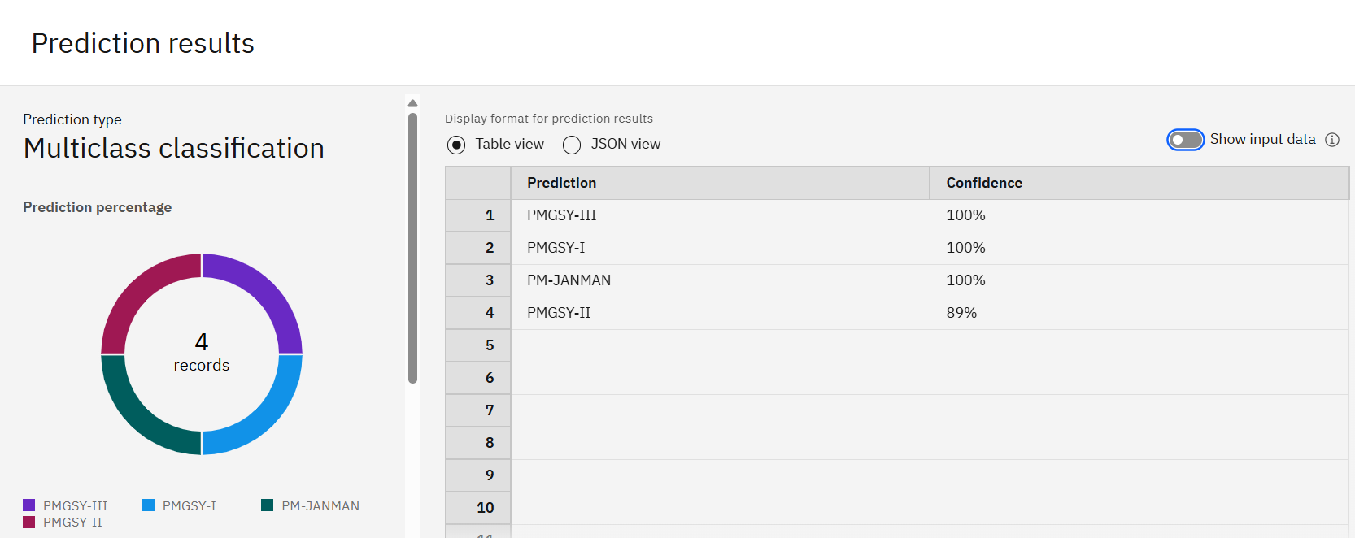
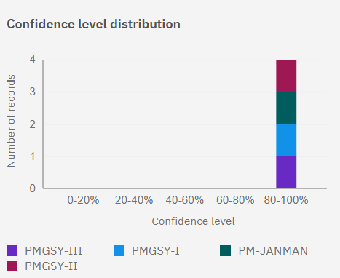
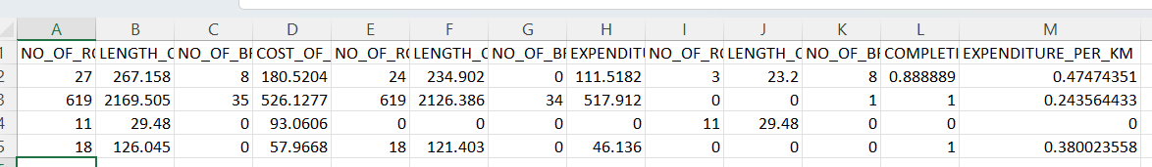
Result
INPUT DATA SET

Slide 8
Conclusion
The machine learning model effectively classifies PMGSY projects based on performance and cost metrics.
IBM Auto AI simplified model creation, requiring minimal manual tuning.
This approach enables:
Faster classification
Improved scheme-based analytics
Scalable support for decision-making in rural infrastructure

Slide 9
Future scope
Add new data sources (GIS, terrain, weather)
Optimize models with advanced ML techniques
Expand to multiple states and regions
Use deep learning for complex pattern detection
Enable edge computing for rural, real-time use
Build mobile/dashboard interfaces for field teams
Automate data pipelines and model updates

Slide 10
References
Ministry of Rural Development – PMGSY Guidelines
IBM Watson Studio & AutoAI Documentation
Open Government Data (OGD) Platform India
Research publications on scheme classification using ML
UCI Machine Learning Repository – Format inspiration

Slide 11

IBM Certifications

Slide 12

IBM Certifications

Slide 13

IBM Certifications

Slide 14
THANK YOU

